Slide 1

22년 삼성 AI 전문가과정
6월 7일 화요일 5교시
장병탁
인공지능
6차시 : Logical Inference
서울대학교 컴퓨터공학부
담당 교수: 장병탁
Seoul National University
Byoung-Tak Zhang

Slide 2
Lecture Overview
인공지능
6차시 : Logical Inference
서울대학교 컴퓨터공학부
담당 교수: 장병탁
Seoul National University
Byoung-Tak Zhang

Slide 3
Introduction
Knowledge-based agents (Previous lecture)
Represent knowledge about the world
Deduce the actions to take
Representing knowledge using logic (Previous lecture)
Propositional logic (PL)
First-order logic (FOL)
Inference in first-order logic (This lecture)
Propositionalization
Forward chaining
Backward chaining
Resolution inference

Slide 4
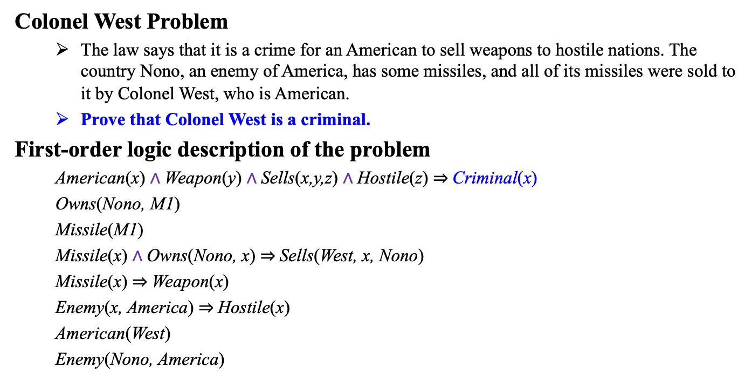
Knowledge in First-Order Logic: Colonel West Problem
Colonel West Problem
The law says that it is a crime for an American to sell weapons to hostile nations. The country Nono, an enemy of America, has some missiles, and all of its missiles were sold to it by Colonel West, who is American.
Prove that Colonel West is a criminal.
First-order logic description of the problem
American(x) $∧$Weapon(y) $∧$Sells(x,y,z) $∧$Hostile(z) $⇒$Criminal(x)
Owns(Nono, M1)
Missile(M1)
Missile(x) $∧$Owns(Nono, x) $⇒$Sells(West, x, Nono)
Missile(x) $⇒$Weapon(x)
Enemy(x, America) $⇒$Hostile(x)
American(West)
Enemy(Nono, America)
Criminal(West)?

Slide 5
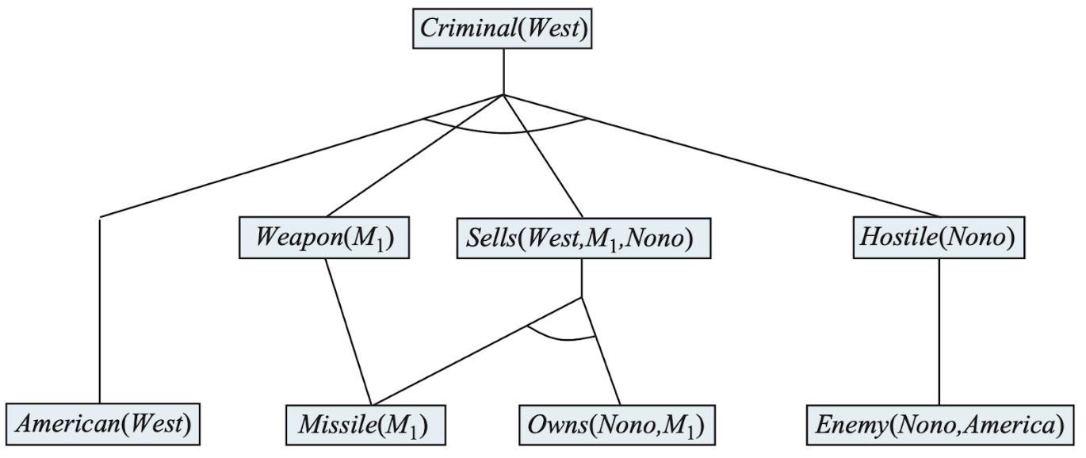

Inference in FOL: Proof Tree
How can answer any answerable first-order logic question?
There are four major ways to make inferences in FOL.
Propositionalization
Forward chaining
Backward chaining
Resolution inference
Proving if Colonel West is a criminal
출처: Stuart J. Russell and Peter Norvig (2021). Artificial Intelligence: A Modern Approach (4rd Edition). Pearson

Slide 6
Outline (Lecture 6)
6.1 Propositional vs. First-Order Inference ..........
6.2 Unification and Lifting ...................................
6.3 Forward Chaining ...........................................
6.4 Backward Chaining ........................................
6.5 Resolution .......................................................
Summary ................................................................
6
12
17
24
29
34

Slide 7
6.1 Propositional vs. First-Order Inference

Slide 8
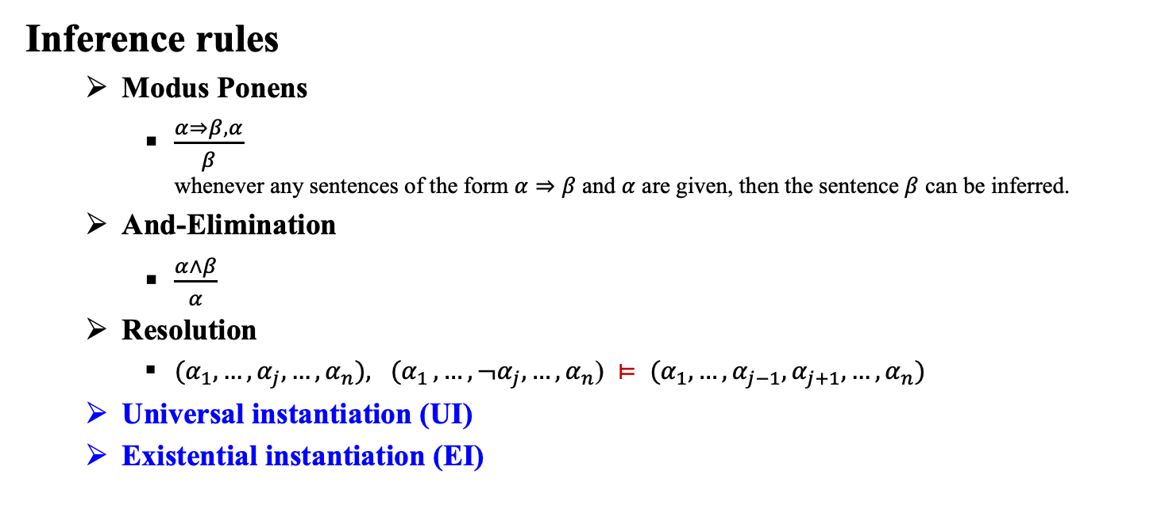
6.1 Propositional vs. First-Order Inference (1/5)
Inference rules
Modus Ponens
$\frac{α⇒β, α}{β}$ whenever any sentences of the form $α⇒β$ and $α$ are given, then the sentence $β$ can be inferred.
And-Elimination
$\frac{α∧β}{α}$
Resolution
${(α}_{1}, …, {α_{j},…,α}_{n}){, (α}_{1}, …, {¬α_{j},…,α}_{n}$) $⊨$ ${(α}_{1}, …, {α_{j−1},α_{j+1},…,α}_{n})$
Universal instantiation (UI)
Existential instantiation (EI)
Both for PL & FOL
new for FOL

Slide 9

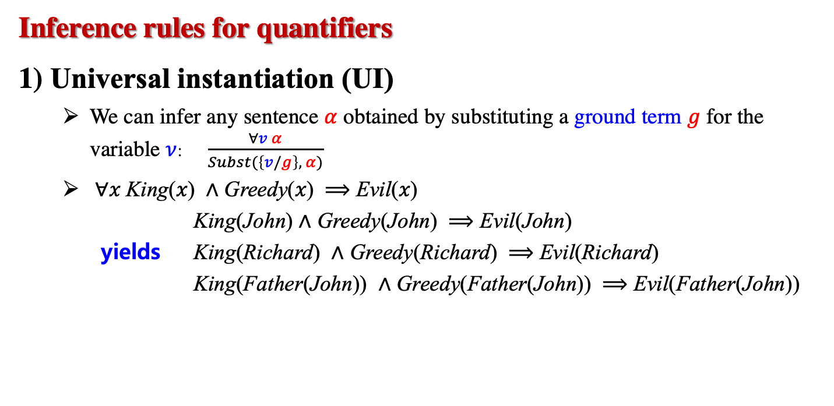
6.1 Propositional vs. First-Order Inference (2/5)
Inference rules for quantifiers
1) Universal instantiation (UI)
We can infer any sentence $α$ obtained by substituting a ground term $g$ for the variable $ν$: $\frac{∀v α}{Subst(\left\{v/g\right\}, α)}$
∀𝑥 King(𝑥) ∧ Greedy(𝑥) ⟹ Evil(𝑥)
King(John) ∧ Greedy(John) ⟹ Evil(John)
yields King(Richard) ∧ Greedy(Richard) ⟹ Evil(Richard)
King(Father(John)) ∧ Greedy(Father(John)) ⟹ Evil(Father(John))
$∀$𝑥 Smart(x)

Slide 10
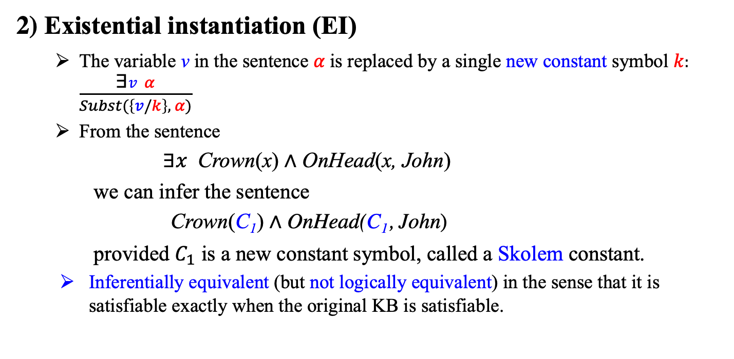
6.1 Propositional vs. First-Order Inference (3/5)
2) Existential instantiation (EI)
The variable v in the sentence $α$is replaced by a single new constant symbol $k:$ $\frac{\text{∃}v α}{Subst(\left\{v/k\right\}, α)}$
From the sentence
∃𝑥 Crown(x) ∧ OnHead(x, John)
we can infer the sentence
Crown(C₁) ∧ OnHead(C₁, John)
provided $C_{1}$ is a new constant symbol, called a Skolem constant.
Inferentially equivalent (but not logically equivalent) in the sense that it is satisfiable exactly when the original KB is satisfiable.
∃𝑥 Smart(x)

Slide 11
6.1 Propositional vs. First-Order Inference (4/5)
Reduction to Propositional Inference
Suppose the KB contains just the following
∀x King(x) ∧ Greedy(x) ⟹ Evil(x)
King(John)
Greedy(John)
Brother(Richard, John)
Instantiating the universal sentence in all possible ways, {x/John} and {x/Richard}, we have
King(John) ⋀ Greedy(John) ⟹ Evil(John)
King(Richard) ⋀ Greedy(Richard) ⟹ Evil(Richard)
The new KB is propositionalized:
King(John), Greedy(John), Evil(John), King(Richard), etc.

Slide 12
6.1 Propositional vs. First-Order Inference (5/5)
Technique of Propositionalization
First-order inference via propositionalization is complete– that is, any entailed sentence can be proved.
What happens when the sentence is not entailed? We cannot tell.
The question of entailment for first-order logic is semidecidable—that is, algorithms exist that say yes to every entailed sentence, but no algorithm exists that also says no to every non-entailed sentence.
Cf. The halting problem for Turing machines.

Slide 13
6.2 Unification and Lifting

Slide 14
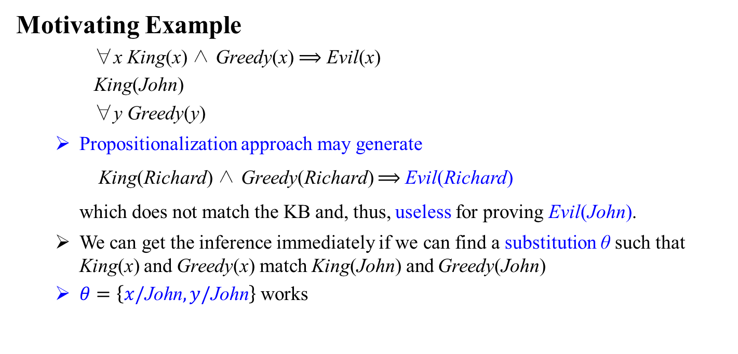
6.2 Unification and Lifting (1/4)
Motivating Example
∀x King(x) ∧ Greedy(x) ⟹ Evil(x)
King(John)
∀y Greedy(y)
Propositionalization approach may generate
King(Richard) ∧ Greedy(Richard) ⟹ Evil(Richard)
which does not match the KB and, thus, useless for proving Evil(John).
We can get the inference immediately if we can find a substitution θ such that King(x) and Greedy(x) match King(John) and Greedy(John)
$θ=\left\{x/\text{John}, y/\text{John}\right\}$ works

Slide 15
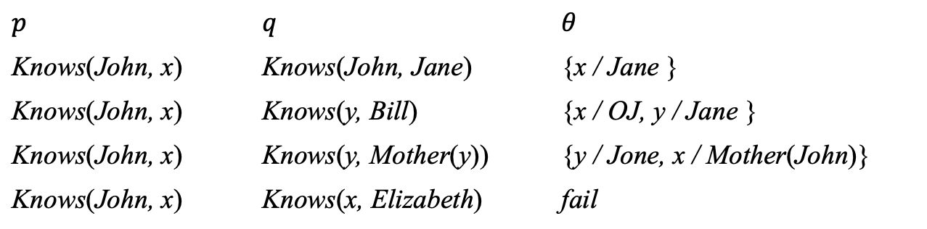

6.2 Unification and Lifting (2/4)
Unification
$\text{Unify}\left(p, q\right)=θ \text{where} pθ=qθ$ ($θ:m$ost general unifier (MGU))
Lifted inference rules require finding substitutions that make different logical expressions look identical. This process is called unification.
$$p$$ | $$q$$ | $$θ$$
Knows(John, x) | Knows(John, Jane) | {x / Jane }
Knows(John, x) | Knows(y, Bill) | {x / OJ, y / Jane }
Knows(John, x) | Knows(y, Mother(y)) | {y / Jone, x / Mother(John)}
Knows(John, x) | Knows(x, Elizabeth) | fail

Slide 16
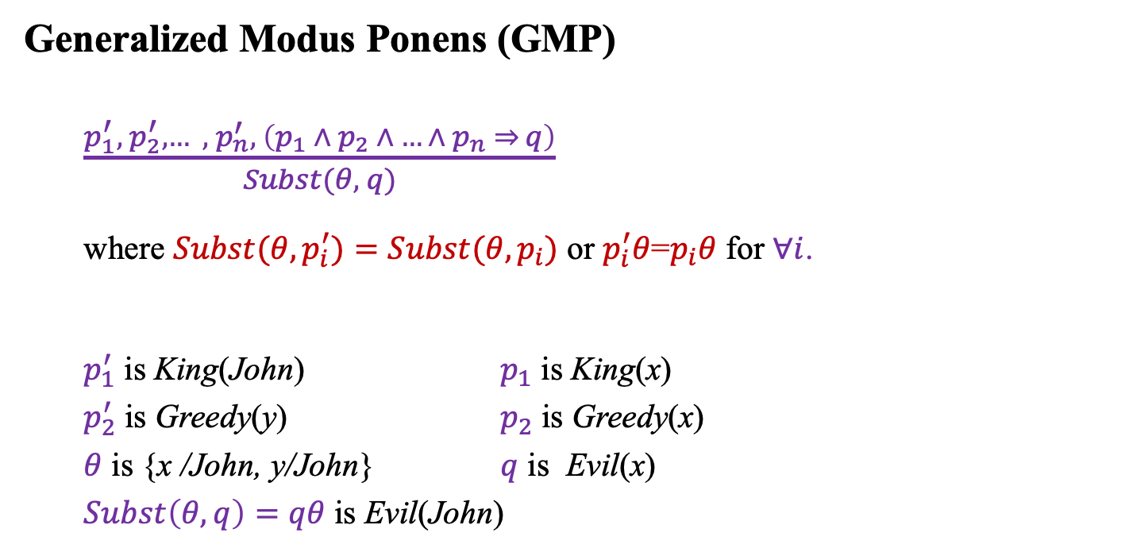
6.2 Unification and Lifting (3/4)
Generalized Modus Ponens (GMP)
$\frac{p_{1}^{′}, { p}_{2}^{′}, … , { p}_{n}^{′}, \left(p_{1} ∧ p_{2} ∧ … ∧ p_{n} ⇒ q\right)}{Subst(θ, q)}$
where ${Subst(θ, p}_{i}^{′})={Subst(θ,p}_{i})$ or $p_{i}^{′}θ$=$p_{i}θ$ for $∀i$.
$p_{1}^{′}$ is King(John) $p_{1}$ is King(x)
$p_{2}^{′}$ is Greedy(y) $p_{2}$ is Greedy(x)
$θ$ is {x /John, y/John} $q$ is Evil(x)
$Subst\left(θ, q\right)=qθ$ is Evil(John)
King(John)
∀y Greedy(y)
∀x King(x) ∧ Greedy(x) ⟹ Evil(x)
GMP is a lifted version of MP. It raises MP from ground (variable-free) propositional logic to first-order logic.

Slide 17

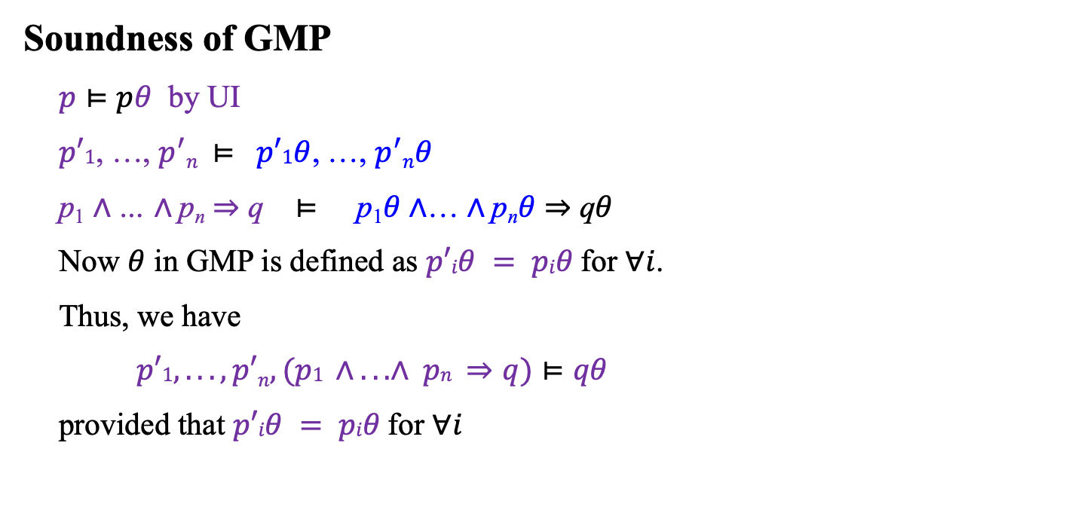
6.2 Unification and Lifting (4/4)
Soundness of GMP
$p⊨pθ$ by UI
$p′1$, …, $p^{′}n ⊨$ $p′1θ$, …, $p^{′}nθ$
p₁ $∧$… $∧$p_{n} $⇒$ q $⊨$ p₁$θ∧$… $∧$p_{n}$θ$ $⇒$ q$θ$
Now $θ$ in GMP is defined as $p′iθ = piθ$for $∀i$.
Thus, we have
$p′1, . . . , p′n, (p1 ∧ . . . ∧ pn ⇒q)⊨qθ$
provided that $p′iθ = piθ$for $∀i$
$pθ$= $Subst(θ, p)$

Slide 18
6.3 Forward Chaining

Slide 19
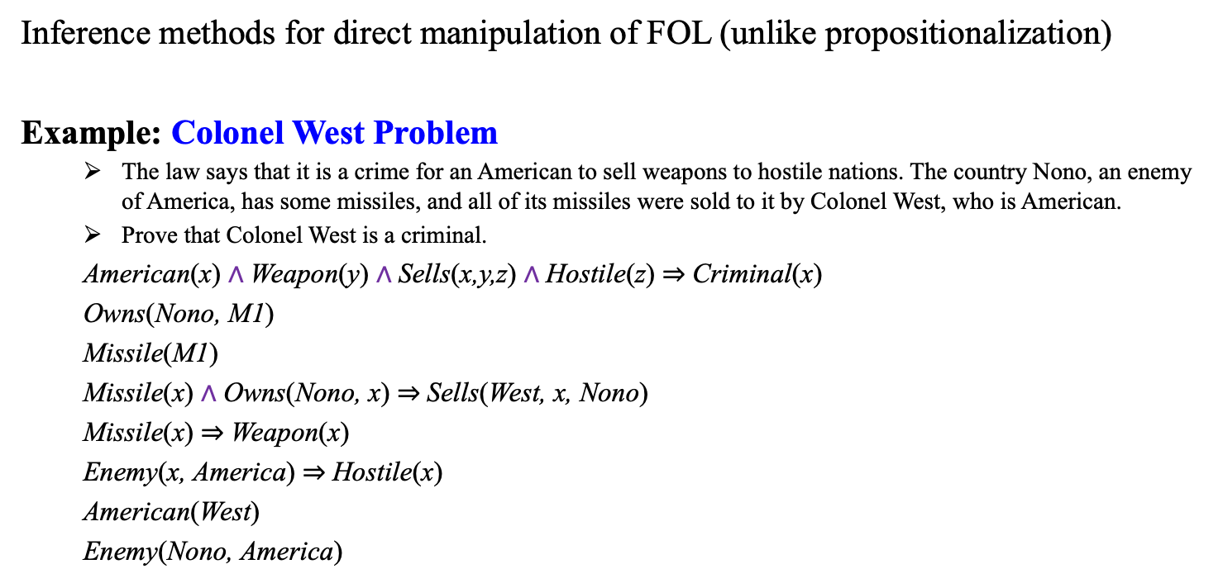
6.3 Forward Chaining (1/6)
Inference methods for direct manipulation of FOL (unlike propositionalization)
Example: Colonel West Problem
The law says that it is a crime for an American to sell weapons to hostile nations. The country Nono, an enemy of America, has some missiles, and all of its missiles were sold to it by Colonel West, who is American.
Prove that Colonel West is a criminal.
American(x) $∧$Weapon(y) $∧$Sells(x,y,z) $∧$Hostile(z) $⇒$Criminal(x)
Owns(Nono, M1)
Missile(M1)
Missile(x) $∧$Owns(Nono, x) $⇒$Sells(West, x, Nono)
Missile(x) $⇒$Weapon(x)
Enemy(x, America) $⇒$Hostile(x)
American(West)
Enemy(Nono, America)
First-order definite clauses
Datalog: First-order definite clauses with no function symbols

Slide 20
6.3 Forward Chaining (2/6)
American(West)
Missile(M1)
Owns(Nono,M1)
Enemy(Nono,America)
출처: Stuart J. Russell and Peter Norvig (2021). Artificial Intelligence: A Modern Approach (4rd Edition). Pearson

Slide 21
6.3 Forward Chaining (3/6)
Weapon(M1)
Sells(West,M1,Nono)
 | Hostile(Nono)
Enemy(Nono,America)
American(West)
Missile(M1)
Owns(Nono,M1)
출처: Stuart J. Russell and Peter Norvig (2021). Artificial Intelligence: A Modern Approach (4rd Edition). Pearson

Slide 22
6.3 Forward Chaining (4/6)
Criminal(West)
Weapon(M1)
Sells(West,M1,Nono)
 | Hostile(Nono)
Enemy(Nono,America)
American(West)
Missile(M1)
Owns(Nono,M1)
출처: Stuart J. Russell and Peter Norvig (2021). Artificial Intelligence: A Modern Approach (4rd Edition). Pearson

Slide 23
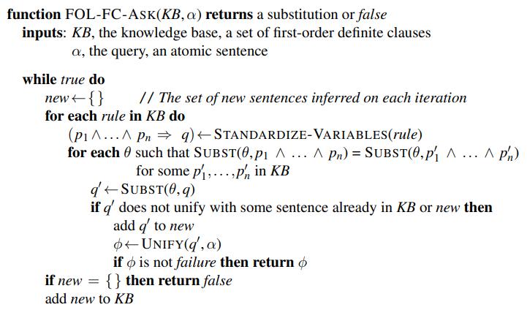
6.3 Forward Chaining (5/6)
Forward chaining algorithm
출처: Stuart J. Russell and Peter Norvig (2021). Artificial Intelligence: A Modern Approach (4rd Edition). Pearson

Slide 24
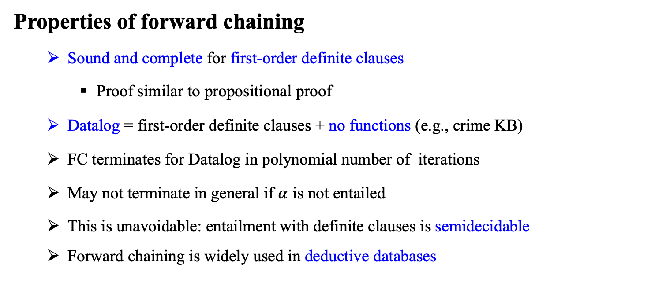
6.3 Forward Chaining (6/6)
Properties of forward chaining
Sound and complete for first-order definite clauses
Proof similar to propositional proof
Datalog = first-order definite clauses + no functions (e.g., crime KB)
FC terminates for Datalog in polynomial number of iterations
May not terminate in general if $α$ is not entailed
This is unavoidable: entailment with definite clauses is semidecidable
Forward chaining is widely used in deductive databases

Slide 25
6.4 Backward Chaining

Slide 26
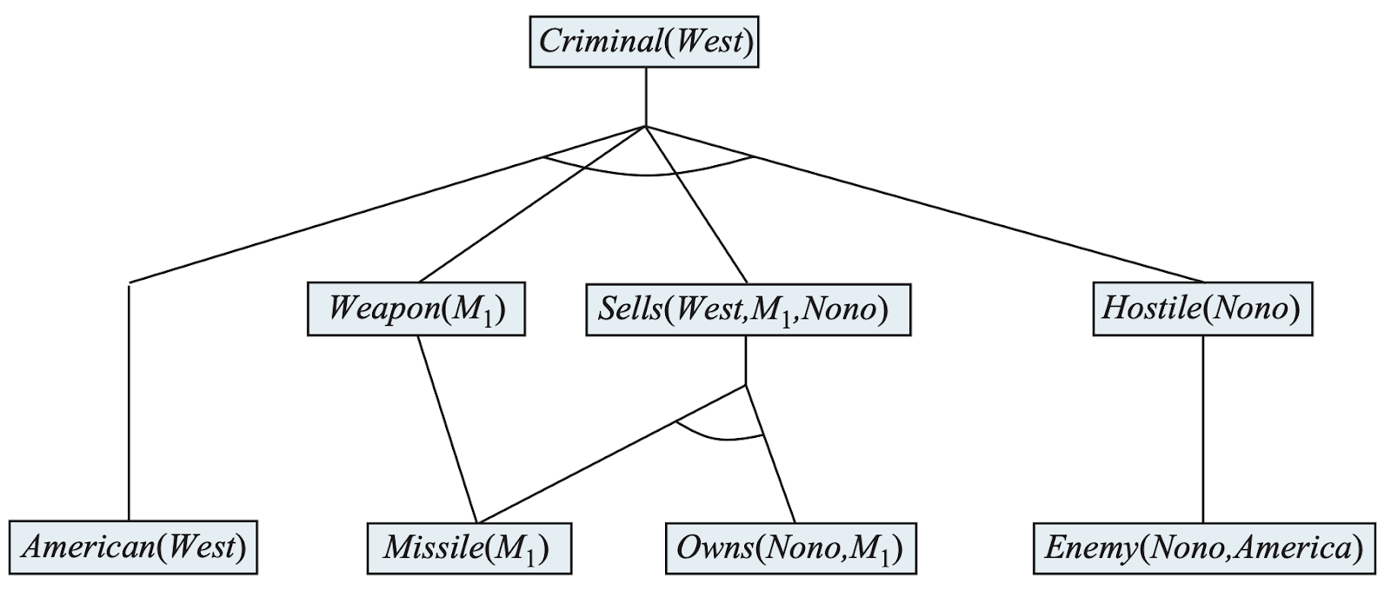
6.4 Backward Chaining (1/4)
The proof tree generated by forward chaining on the crime example.
The initial facts appear at the bottom level, facts inferred on the first iteration in the middle level, and facts inferred on the second iteration at the top level.
출처: Stuart J. Russell and Peter Norvig (2021). Artificial Intelligence: A Modern Approach (4rd Edition). Pearson

Slide 27
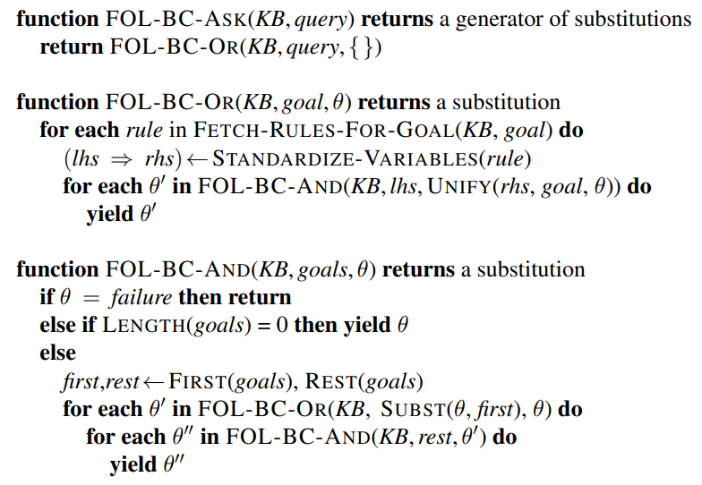
6.4 Backward Chaining (2/4)
A simple backward-chaining algorithm for first-order knowledge bases
출처: Stuart J. Russell and Peter Norvig (2021). Artificial Intelligence: A Modern Approach (4rd Edition). Pearson

Slide 28
6.4 Backward Chaining (3/4)
Properties of backward chaining
Depth-first recursive proof search: space is linear in size of proof
Incomplete due to infinite loops
fix by checking current goal against every goal on stack
Inefficient due to repeated subgoals (both success and failure)
fix using caching of previous results (extra space!)
Widely used (without improvements!) for logic programming

Slide 29
6.4 Backward Chaining (4/4)
Logic programming (PROLOG)
Algorithm = Logic + Control
Prolog program = sets of definite clauses
criminal(X) :- american(X), weapon(Y), sells(X, Y, Z), hostile(Z)
append([], Y, Y).
append([A|X], Y, [A|Z]) :- append(X, Y, Z)
Prolog uses database semantics, i.e. closed-world assumption and negation as failure
Depth-first backward-chaining search
append(X, Y, [1,2])
→
X=[] Y=[1,2];
X=[1] Y=[2];
X=[1,2] Y=[]

Slide 30
6.5 Resolution

Slide 31
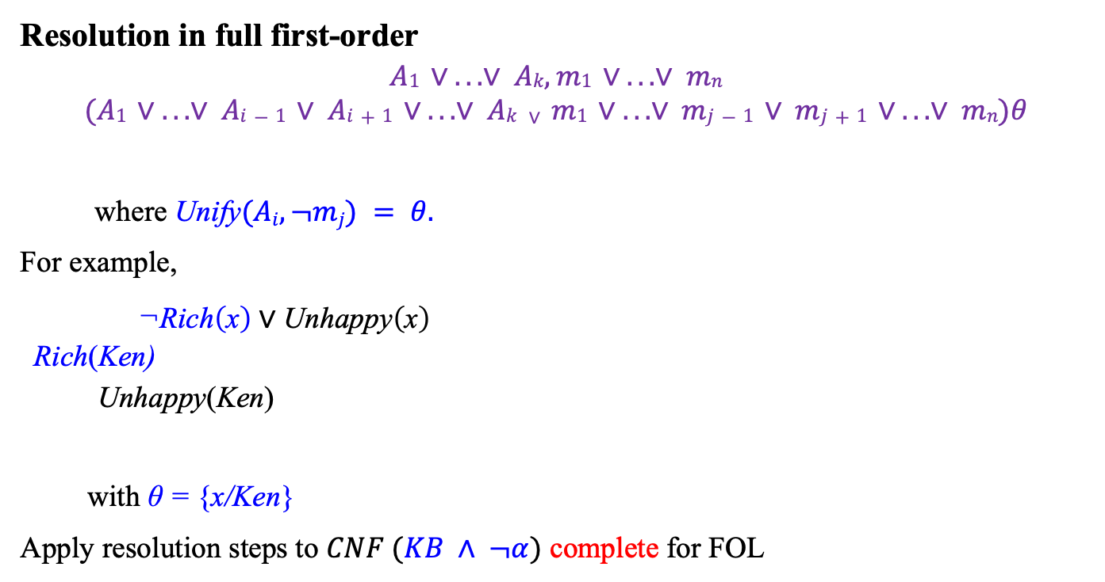
6.5 Resolution (1/4)
Resolution in full first-order
$$A1 ∨ ...∨ Ak, m1 ∨ ...∨ mn$$
$$(A1 ∨ ...∨ Ai−1 ∨ Ai+1 ∨ ...∨ Ak ∨ m1 ∨ ...∨ mj−1 ∨ mj+1 ∨ ...∨ mn)θ$$
where Unify$(Ai, ¬mj) = θ.$
For example,
$\text{¬}\text{Rich}\left(\text{x}\right) \text{∨} \text{Unhappy}\left(\text{x}\right)$
$$\text{Rich}\text{(}\text{Ken}\text{)}$$
$$\text{Unhappy}\text{(}\text{Ken}\text{)}$$
with $\text{θ}\text{ = }\text{\{}\text{x}\text{/}\text{Ken}\text{\}}$
Apply resolution steps to $CNF (KB ∧ ¬α)$ complete for FOL

Slide 32
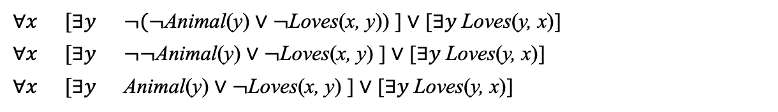
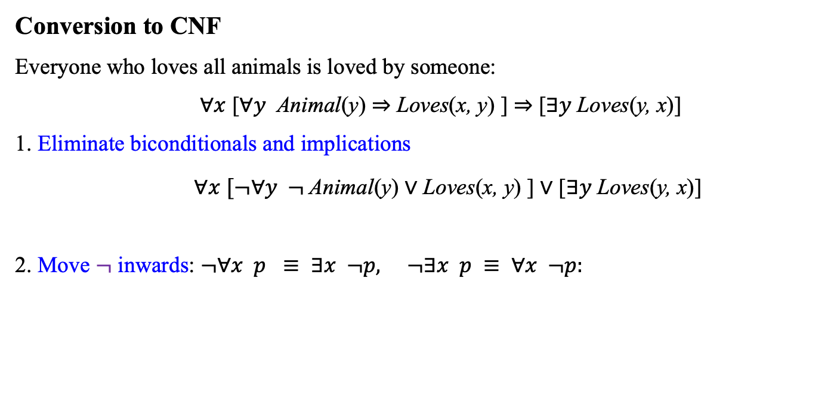
6.5 Resolution (2/4)
Conversion to CNF
Everyone who loves all animals is loved by someone:
$∀x$ [$∀y$ Animal(y) $⇒$ Loves(x, y) ] $⇒$ [$∃y$Loves(y, x)]
1. Eliminate biconditionals and implications
$∀x$ $[¬∀y ¬$Animal(y) $∨$ Loves(x, y) ] $∨$ [$∃y$Loves(y, x)]
2. Move $¬$ inwards: $¬∀x p ≡ ∃x ¬p, ¬∃x p ≡ ∀x ¬p:$
$$∀x$$ | $$[∃y$$ | $¬(¬$Animal(y) $∨$ $¬$Loves(x, y)) ] $∨$ [$∃y$Loves(y, x)]
$$∀x$$ | $$[∃y$$ | $¬¬$Animal(y) $∨$ $¬$Loves(x, y) ] $∨$ [$∃y$Loves(y, x)]
$$∀x$$ | $$[∃y$$ | Animal(y) $∨$ $¬$Loves(x, y) ] $∨$ [$∃y$Loves(y, x)]

Slide 33
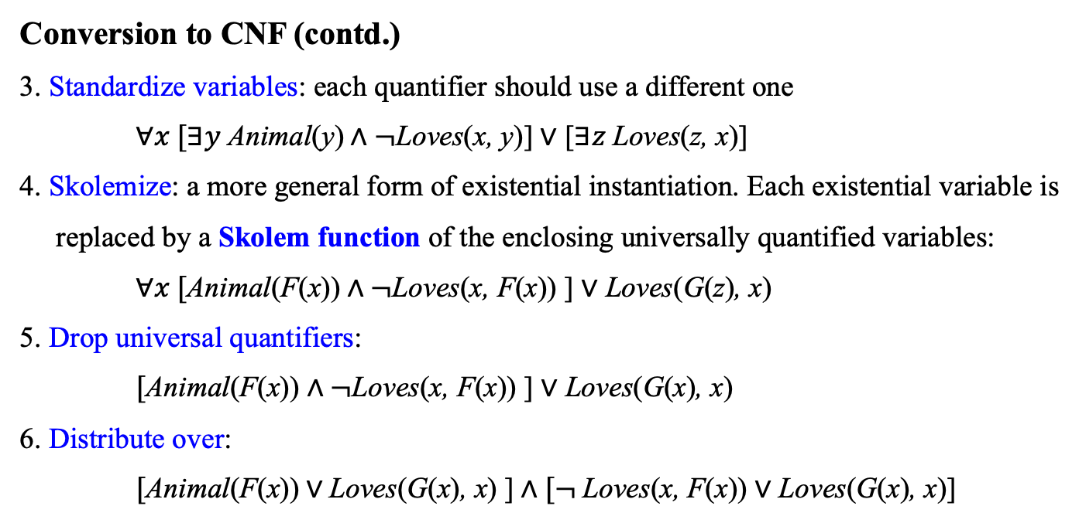
6.5 Resolution (3/4)
Conversion to CNF (contd.)
3. Standardize variables: each quantifier should use a different one
$∀x [∃y$ Animal(y)$∧¬$Loves(x, y)] $∨$ [$∃z$Loves(z, x)]
4. Skolemize: a more general form of existential instantiation. Each existential variable is
replaced by a Skolem function of the enclosing universally quantified variables:
$∀x [$Animal(F(x))$∧¬$Loves(x, F(x)) ] $∨$ Loves(G(z), x)
5. Drop universal quantifiers:
$[$Animal(F(x)) $∧¬$Loves(x, F(x)) ] $∨$ Loves(G(x), x)
6. Distribute over:
$[$Animal(F(x))$∨$Loves(G(x), x) ]$∧[¬$Loves(x, F(x)) $∨$ Loves(G(x), x)]
← CNF

Slide 34
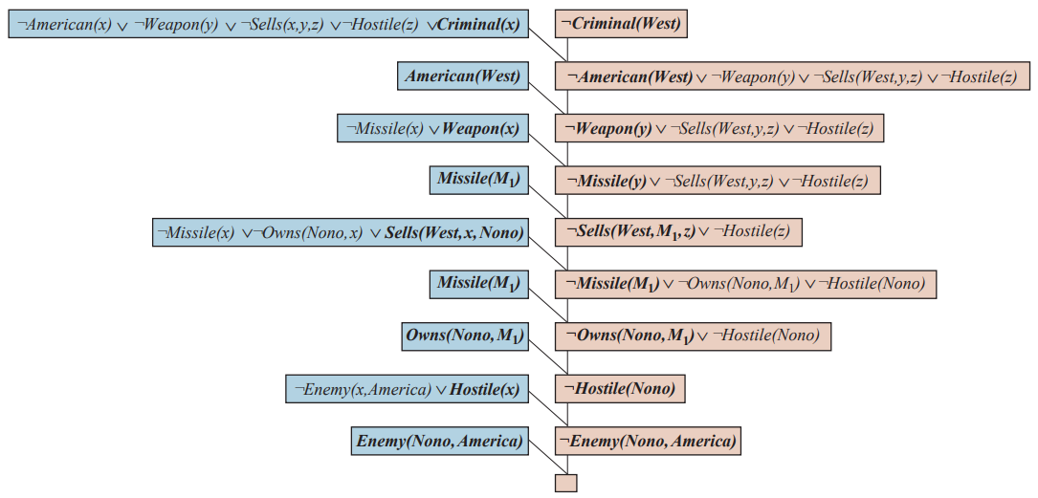
6.5 Resolution (4/4)
Example proofs
출처: Stuart J. Russell and Peter Norvig (2021). Artificial Intelligence: A Modern Approach (4rd Edition). Pearson

Slide 35
Summary
Instantiation is slow, unless the domain is small.
The use of unification to identify appropriate substitutions for variables eliminates the instantiation step in FO proofs, making the process more efficient.
A lifted version of Modus Ponens uses unification to provide a powerful inference rule, generalized Modus Ponens. The forward-chaining and backward-chaining algorithms apply this rule to sets of definite clauses.
Forward chaining is used in deductive databases and production systems. Forward chaining is complete for Datalog.
Prolog, unlike first-order logic, uses a closed world with the unique names assumption and negation as failure.
The generalized resolution inference rule provides a complete proof system for first-order logic, using knowledge bases in CNF.

